Slide 1
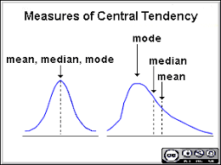
Measure of Central Tendency
Aim-: To provide an accurate description of the entire data in the distribution.
Definition-: It is the single value (statistical measure) which is represents the whole set of data or entire distribution.
e.g.-: Mean, median, mode, quartiles, percentiles etc.
Desired properties-:
1) It should be based on all observations in data set.
2) It should be easily computable & least affected by extreme values.
3) Least fluctuate from sample to sample drawn from same population.
In Statistics, the mean, median, and mode are the three most common measures of central tendency. Each one calculates the central point using a different method. Choosing the best measure of central tendency depends on the type of data(distribution) you have.

Slide 2
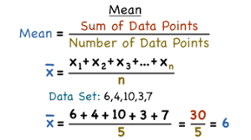
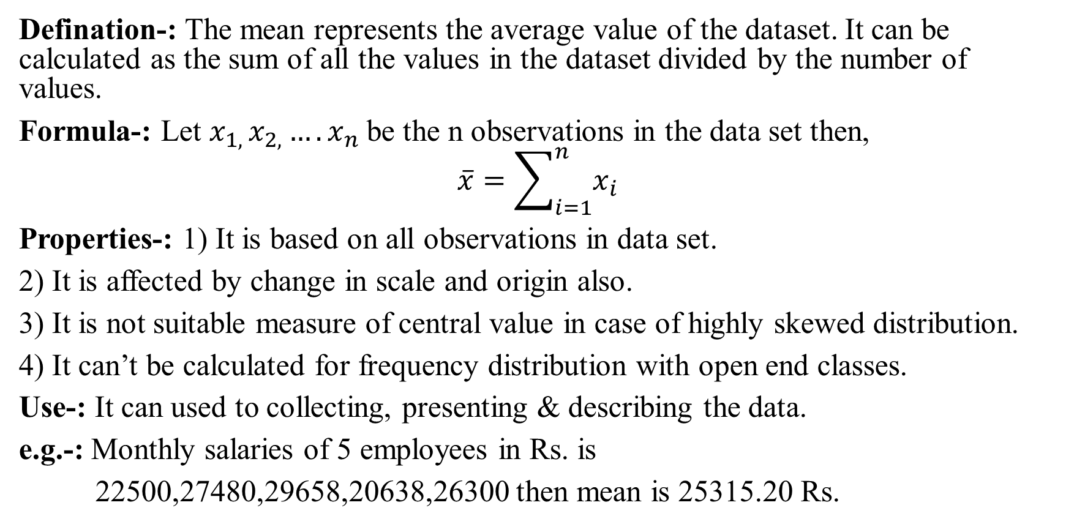
Mean
Defination-: The mean represents the average value of the dataset. It can be calculated as the sum of all the values in the dataset divided by the number of values.
Formula-: Let $x_{1, }x_{2,}….x_{n}$be the n observations in the data set then,
$$\overline{x}=\sum_{i=1}^{n}{x_{i}}$$
Properties-: 1) It is based on all observations in data set.
2) It is affected by change in scale and origin also.
3) It is not suitable measure of central value in case of highly skewed distribution.
4) It can’t be calculated for frequency distribution with open end classes.
Use-: It can used to collecting, presenting & describing the data.
e.g.-: Monthly salaries of 5 employees in Rs. is
22500,27480,29658,20638,26300 then mean is 25315.20 Rs.

Slide 3
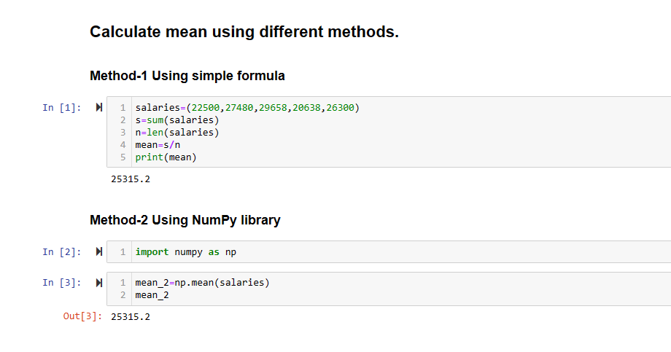
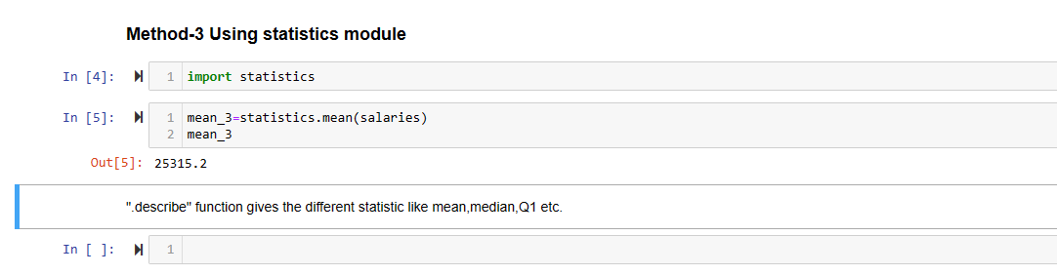
Implementation in Python

